Slide 1
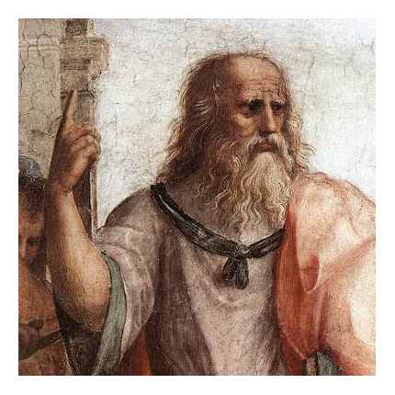
HUMA2921 Ethical Theories and Contemporary Issues
Prof. Plato Tse
NCCU & HKUST

Slide 2
Moral Relativism
Theory of Right Conduct
An action A, performed by a member of C, is obligatory iff, according to the basic moral norms of C, A is required.
An action A, performed by a member of C, is wrong iff, according to the basic moral norms of C, A is prohibited.
An action A, performed by a member of C, is optional iff, according to the moral norms of C, A is neither required nor prohibited.

Slide 3
Context Sensitivity Thesis
MR: What is right and what is wrong for the members of a culture depend on (are ultimately determined by) the basic moral norms of their culture.
MO: There are at least some moral norms whose correctness or truth is independent of the moral norms a culture does or might accept. Such norms express objectively true moral standards for all cultures regardless of whether they recognize or heed them.

Slide 4
Context Sensitivity Thesis
CS: what is right or wrong for someone to do often depends on one’s circumstances, including facts about one’s culture.
CS is not equivalent to MR. Why?
Because CS is (while MR is not) compatible with MO.

Slide 5
Context Sensitivity Thesis
Suppose you are an expert swimmer and one day while walking along a deserted beach, you see a young child struggling in the water, obviously in immediate danger of drowning. What should you do?
Suppose I am in the same situation, but I can’t swim. What should I do?

Slide 6
Context Sensitivity Thesis
While what you ought to do and what I ought to do are different, they may well be determined by an objective moral principle, i.e.: One ought to help those in need of help when one can do so while avoiding a serious risk of life and limb to oneself.
The rightness or wrongness of an action partly depends on non-moral facts that hold in the context in question—facts concerning agents and their circumstances.

Slide 7
Moral Diversity Thesis
MD:
The moral codes of some cultures include basic moral norms that conflict with the basic moral norms that are part of the moral codes of other cultures.
Such fundamental conflicts are widespread.

Slide 8
Moral Diversity Thesis
Question: If MR is true, does it follow that MD must also be true?
Even if it turns out (now or sometime in the future) that all cultures accept the same set of basic moral norms, moral relativism might still be true.
Analogy: It could be universal to drive on the right-hand side and still be a matter of convention.

Slide 9
Anthropologist’s Argument – ver. 1
Different cultures have different moral codes. (=MD)
If MD is true, then there are no objectively true moral norms applying to all cultures.
If there are no universally valid moral norms applying to all cultures, then what is right and what is wrong for the members of a culture depend on the basic moral norms of their culture (= MR).
Thus, MR is true.

Slide 10
Challenges
Against P2
The mere difference in belief over some issue does not imply that there is no single correct belief about that issue.
Take for example the historical dispute in belief about the shape of the earth.

Slide 11
Challenges
Against P1
It is possible for there to be differences across cultures in their moral beliefs without fundamental moral disagreements.
A deeper analysis is required.

Slide 12
Nonfundamental Moral Disagreements
Imagine we hold contrary views regarding the morality of capital punishment. Your line of reasoning:
A society ought to employ only those punishments that have overall uniquely beneficial consequences for society.
Capital punishment does not have overall uniquely beneficial consequences for society.
Therefore, capital punishments ought to be abolished.

Slide 13
Nonfundamental Moral Disagreements
My line of reasoning:
A society ought to employ only those punishments that have overall uniquely beneficial consequences for society.
Capital punishment does have overall uniquely beneficial consequences for society.
Therefore, it is not the case that capital punishments ought to be abolished.
Non-fundamental: disagreement due to differences in non-moral beliefs

Slide 14
Fundamental Moral Disagreements
My line of reasoning:
A society ought to employ only those punishments that involve inflicting harm on the wrongdoer that is equivalent to the harm that the wrongdoer inflicted on his or her victim.
Capital punishment inflicts harm on the wrongdoer that is equivalent to the harm that the wrongdoer inflicted on his or her victim.
Thus, capital punishment ought to be employed.

Slide 15
MD Revisited
If intercultural moral disagreements can almost always be explained in terms of intercultural differences in the relevant non-moral beliefs, then the second claim of the MD thesis is false.
MD requires evidence of widespread fundamental disagreements, which is far from being firmly established.
Difference of the two types of disagreements: resolvability by rational means

Slide 16
Different cultures have different moral codes. (=MD)
Such conflicts cannot be resolved by rational means.
There are widespread and rationally irresolvable intercultural conflicts over basic moral norms.
The best explanation for such irresolvable conflicts is that there are no objectively true moral norms applying to all cultures.
Anthropologist’s Argument – ver. 2

Slide 17
Anthropologist’s Argument – ver. 2
If there are no objectively true moral norms applying to all cultures (= denial of MO), then what is right and what is wrong for the members of a culture depend on the basic moral norms of their culture (= MR).
Thus, what is right or wrong depends on the basic moral norms of the culture in which the action is performed (MR).

Slide 18
Suppose we encounter someone who does not think it is morally wrong to engage “games” like “chicken pull.”
The individual shares the same non-moral beliefs about animals.
It is just that his moral code does not include a norm prohibiting such treatment of animals.
The proper response is to insist that this individual is mistaken and to urge him to exercise sympathy.
An Objectivist Response

Slide 19
Problems of Formulation
Consistency
Suppose that Susan is a member of the Roman Catholic Church, which forbids almost all abortions, but that she is also a member of the Democratic Party, whose moral code does not forbid abortion and condones it in a wide variety of cases.
Having an abortion would be both right and wrong, if moral relativism is true.

Slide 20
Usability & Determinacy
Absent a determinate account of what counts as a culture, one would not be able to specify what it is that makes an action right or wrong.
By language? Ethnic origins? Religious affiliations? Political views?
Problems of Formulation

Slide 21
Problem of Intercultural Evaluation
If MR is true, the basic moral norms of a culture set the very standard for right and wrong, then it makes no sense to question the correctness of those norms—they just are the ultimate standards for the relevant culture.
But surely it makes sense.

Slide 22
Preachers and politicians talk about how morality has declined.
We may also claim that our moral code has improved over time, especially concerning racial and gender equality.
Can such comparative claims make sense for the moral relativist?
Problem of Intracultural Evaluation

Slide 23
Moral Reformer Problem
If MR is true, whenever a member of a culture attempts to reform its moral code and publicly opposes its practice, he is in the wrong.

Slide 24
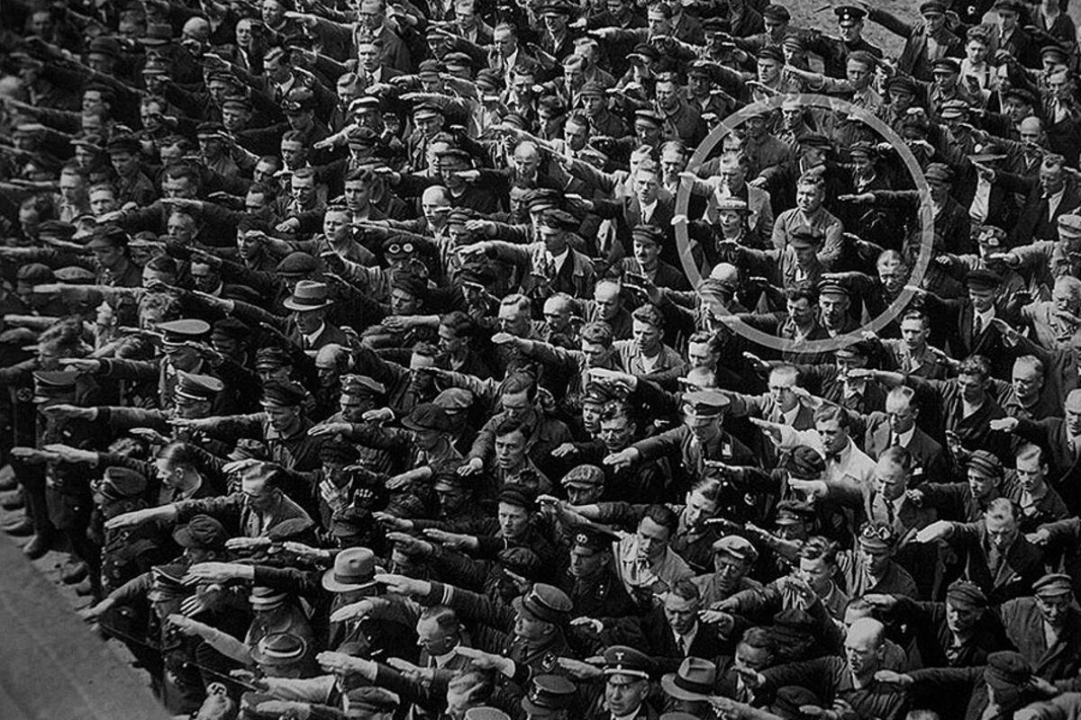
Internal Support & Explanatory Power
Internal support
It is conceivable that a culture’s basic moral norms conflict with one’s considered moral beliefs. Take Nazi Germany’s antisemitism for example.
Explanatory power
Failure of internal support at the same a failure of explanation

Slide 25
Restricted Moral Relativism
What is right and what is wrong for the members of a culture depend on the basic moral norms of their culture, but only in cases where those norms are consistent with those universal constraints on an adequate morality that properly reflect the functions of morality as well as facts about human nature.

Slide 26

Culture-independent constraints
Intrapersonal as well as interpersonal functions of morality, and
Facts about human nature
The satisfaction of their physical needs
The goods of intimacy, sociability, and social status
Knowledge of the physical and the human world
Restricted Moral Relativism

Slide 27
Restricted Moral Relativism
Interpersonal function of morality
Yields a norm of reciprocity of returning good for good
Encourage other-regarding behaviour
Allows room for personal freedom
Norms must be seen as justifiable

Slide 28
Not anything goes.
Pluralistic
Moral codes that imply different moral verdicts could be equally correct or true, provided that they satisfy the constraints.
Restricted Moral Relativism

Slide 29
Relativism and Tolerance
MR seems to commit one to a principle of tolerance.
If one wants to promote tolerance, then one ought to accept MR.
Principle of Tolerance:
It is morally wrong for any culture to interfere with the moral practices of another culture.

Slide 30
Does MR really commit one to accept this principle of tolerance?
The unrestricted version is incompatible with it. Why?
Only the restricted version is compatible with it.
However, it does not mean that other views lead to intolerance.
Restricted Moral Relativism

